Slide 1

Customer Shopping Behavior Analysis
Uncovering strategic insights from transactional data.

Slide 2

Project Overview & Data Scope
Project Goal
3,900
18
Analyze 3,900 customer transactions to uncover spending patterns, segmentation, and product preferences.
Total Records
Total Columns
Support strategic decision-making and enhance business performance.

Slide 3
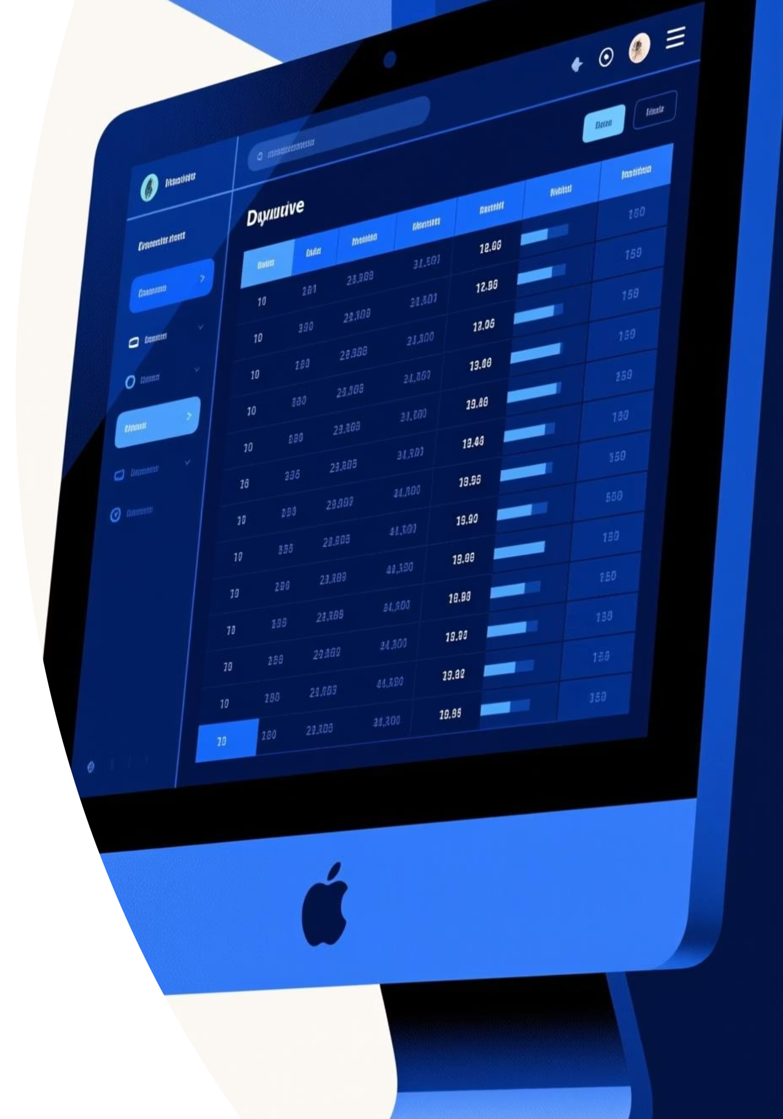




Key Data Features
Demographics
Purchase Details
Age, Gender, Location, Subscription Status.
Item, Category, Amount, Season, Size, Color.
Shopping Behavior
Discount, Previous Purchases, Frequency, Review Rating, Shipping Type.

Slide 4
Exploratory Data Analysis (EDA) & Preparation
Missing Data Handling
Data Loading & Exploration
Imputed 37 missing Review Rating values using median rating by product category.
Imported dataset using pandas. Inspected structure and summary statistics.
Feature Engineering
Standardization & Consistency
Created age_group and derived purchase_frequency_days.
Renamed columns to snake_case. Dropped redundant 'promo_code_used' column.

Slide 5


Data Integration for Analysis
Clean Data Loaded to PostgreSQL
The cleaned DataFrame was loaded into PostgreSQL to enable robust, SQL-based business analysis.
This step prepared the data for answering key business questions efficiently.

Slide 6

SQL Analysis: Revenue & Spending
Revenue by Gender
Compared total revenue generated by male vs. female customers.
High-Spending Discount Users
Identified customers using discounts who spent above the average purchase amount.
Subscribers vs. Non-Subscribers
Compared average spending and total revenue by subscription status.
Revenue by Age Group
Calculated total revenue contribution from each age segment.

Slide 7



SQL Analysis: Product & Shipping Insights
Top 5 Products by Rating
Shipping Type Comparison
Discount-Dependent Products
Extracted products with the highest average review ratings.
Analyzed average purchase amounts for Standard vs. Express shipping.
Listed top 5 products with the highest percentage of discounted purchases.

Slide 8
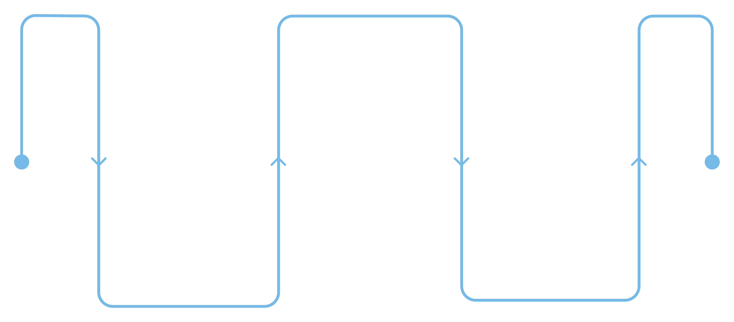
SQL Analysis: Customer Segmentation
Returning Customers
Multiple purchases, medium frequency
New Customers
Loyal Customers
First purchase, low frequency
Frequent buyers (>5), high retention
Customers were classified into segments based on purchase history to enable targeted strategies.
Identified Top 3 Products per Category.
Checked correlation between frequent buyers (>5 purchases) and subscription rates.

Slide 9
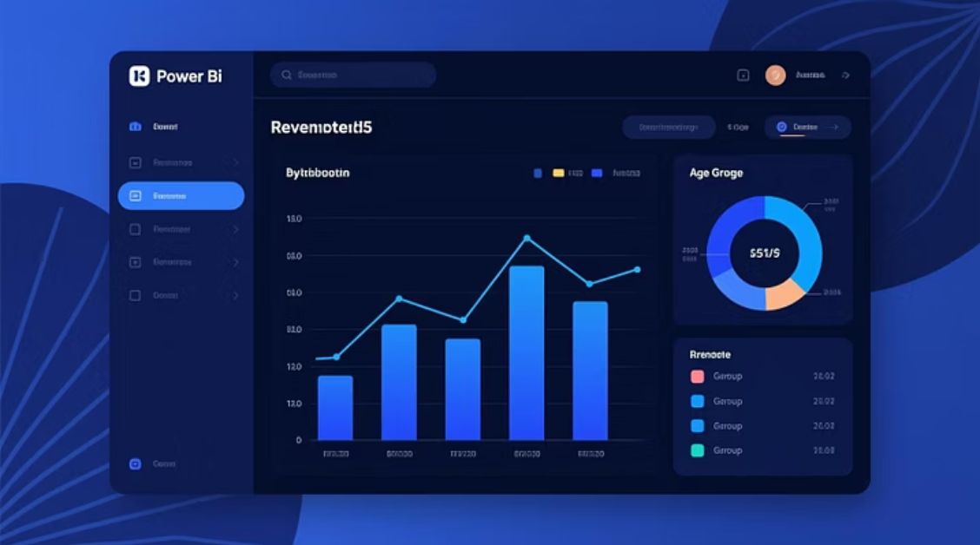
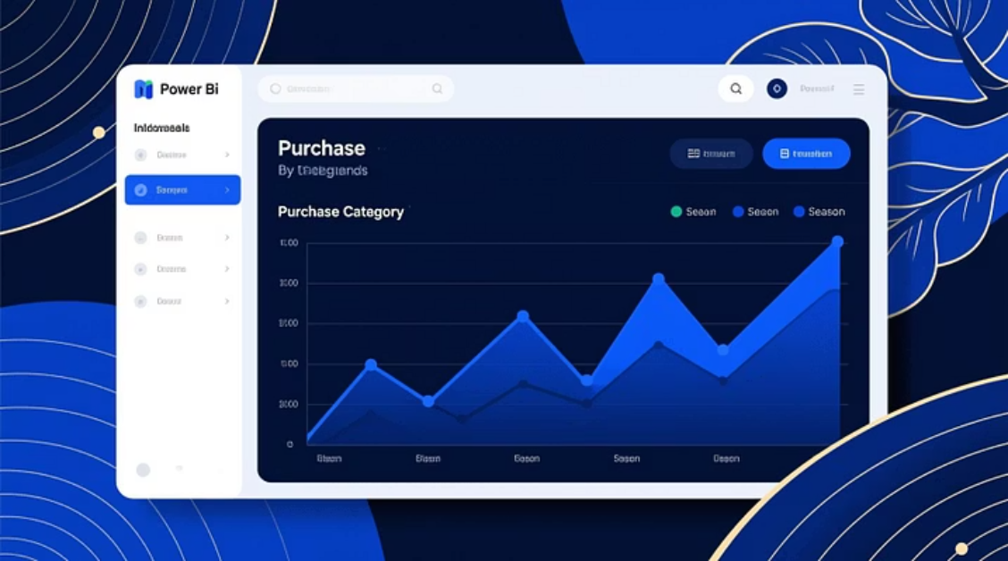
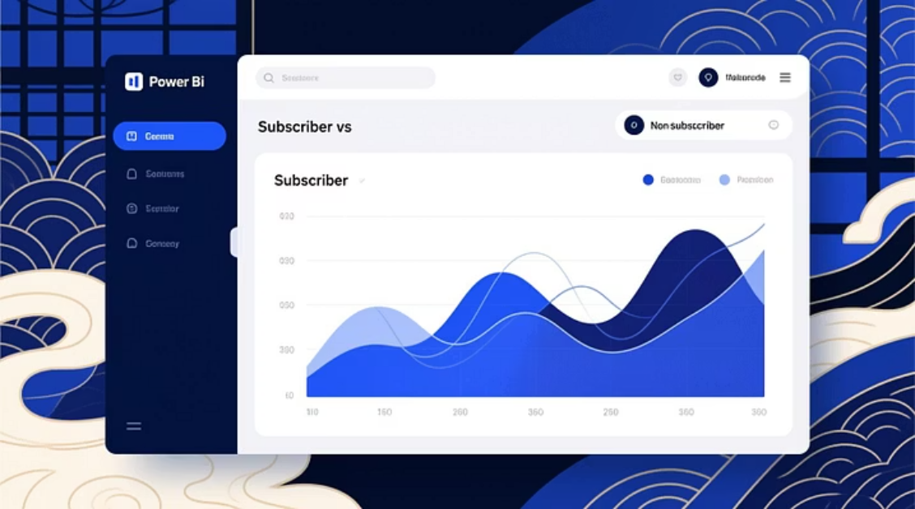
Visualizing Insights: Power BI Dashboard
An interactive dashboard was developed for comprehensive visualization of key customer insights.
Revenue distribution by gender and age group.
Purchase trends, discount utilization, and product performance.

Slide 10

Strategic Business Recommendations
Boost Subscriptions
Promote exclusive benefits and personalized offers.
Loyalty Programs
Introduce reward systems to retain frequent buyers.
Optimize Discount Policies
Balance promotions with profit margins to sustain revenue.
Targeted Marketing
Focus efforts on high-revenue age groups and express shipping customers.

